Slide 1
ML project Diabetes Diagnosis
Under the supervision of :
Dr. Adnan Yahya
Group members :
Reem Salloum
Nima Shoman
Besan Yaseen

Slide 2
Project description
The main objective of this project was to develop software capable of accurately diagnosing diabetes by leveraging available patient data. The initial phase involved organizing and preprocessing medical data, followed by the application of advanced computational techniques such as decision trees and artificial neural networks (ANN). To evaluate the performance of these methods, specific datasets were utilized, presented in a standardized tabular format with established metrics. We carefully selected Python-compatible tools for this purpose, and the effectiveness of the system was tested using varying amounts of data. Additionally, the system's adaptability was demonstrated by its potential application in diagnosing other diseases, serving as an added contribution to the field of medical diagnostics.

Slide 3

Data Set
Blood Pressure
Age
PatientID
Family History
BMI
Gender
Region
Physical Activity
Fasting Glucose
Symptoms
Diagnosis

Slide 4

Data Set
Patient ID | Age | Gender | BMI | Blood pressure | Fasting Glucose | Family History | Physical Acticity | Region | Diagnosis | Region
1 | 67 | Female | 22.8 | 134 | 140 | No | High | Al-Bireh | Negative | Al-Bireh
28 | 28 | Male | 23.5 | 107 | 143 | No | Low | Beitunya | Negative | Beitunya
2 | 70 | Male | 32.2 | 82 | 240 | Yes | Medium | Ramallah | Positive | Ramallah

Slide 5
Algorithms utilized
In our effort to predict diabetes, we employed both Artificial Neural Networks (ANN) and Decision Trees. The Artificial Neural Network algorithm, inspired by the human brain's neural structure, is a powerful machine learning model capable of complex pattern recognition. It consists of interconnected nodes (neurons) organized in layers, enabling it to learn intricate relationships in data. This makes ANN particularly effective for capturing non-linear patterns in patient data, such as the relationship between BMI, blood pressure, and diabetes risk.
On the other hand, Decision Trees are a tree-like model that makes decisions based on features at each node. It recursively splits the data into subsets, making it particularly effective for classification tasks. Decision Trees are intuitive and easy to interpret, making them useful for understanding the key factors that contribute to diabetes prediction, such as family history, physical activity, and fasting glucose levels.

Slide 6

Code implementation
This Python script integrates machine learning models for diabetes analysis and prediction using Decision Trees and Artificial Neural Networks (ANN). It begins by importing necessary libraries, such as pandas for data manipulation and scikit-learn for machine learning tasks. The script includes functions for data preprocessing, model training, and evaluation. The dataset is loaded from an Excel file (DiabetesDataset.xlsx), and categorical columns (e.g., Gender, FamilyHistory, PhysicalActivity) are encoded numerically using LabelEncoder. The data is then split into training and testing sets using train_test_split. Two classifiers are implemented: A Decision Tree Classifier (decision_tree_classifier) for diabetes prediction. An Artificial Neural Network (ANN) (ann_classifier) with hidden layers (200 and 100 neurons) for more complex pattern recognition. The script also includes a Graphical User Interface (GUI) built with Tkinter, allowing users to input patient data (e.g., age, BMI, blood pressure, etc.) and receive diabetes predictions from both the Decision Tree and ANN models. The entered information is processed, scaled using StandardScaler, and fed into the trained models. The prediction results are displayed in the GUI, providing an interactive and user-friendly experience for diabetes analysis.
As an additional step , we utilized the WEKA learning tool to perform calculations on the dataset , including measures like accuracy and precision , etc.

Slide 7
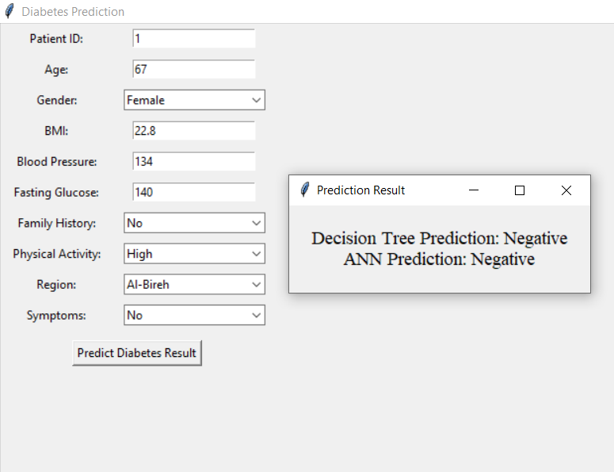

Slide 8
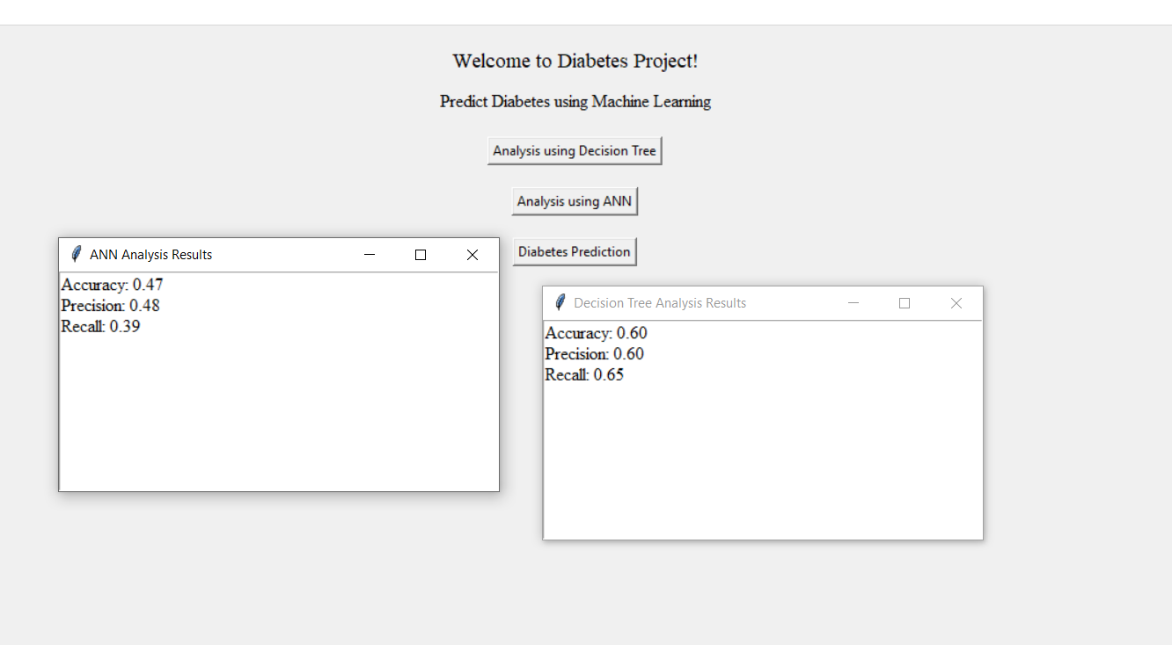
Results

Slide 9
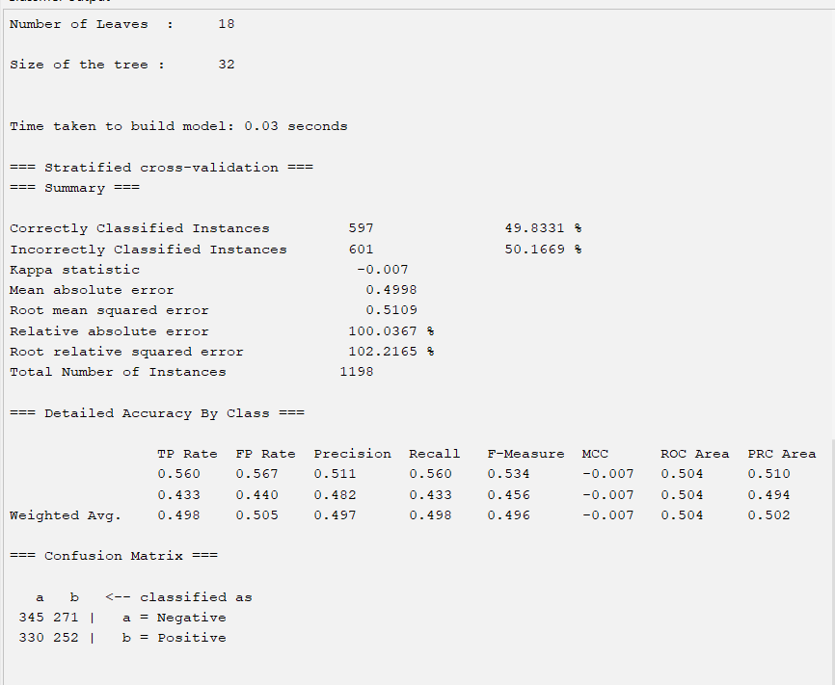
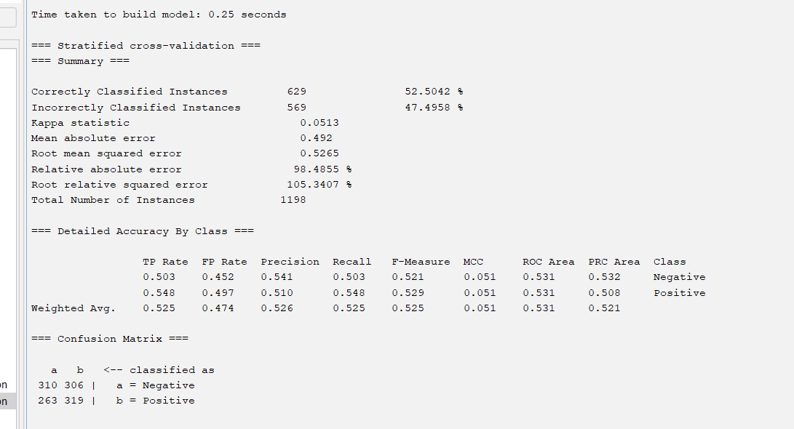
Weqa

Slide 10
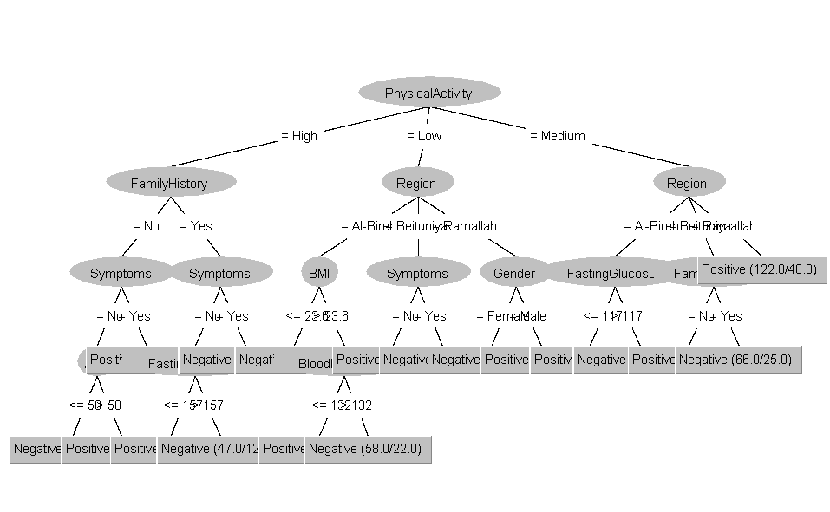
weqa

Slide 11
Thank you for listening

